Slide 1
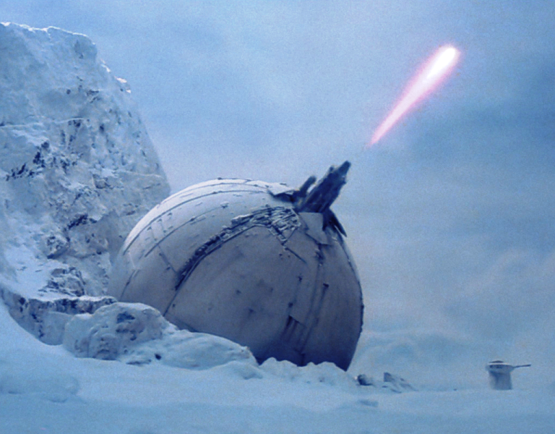
IoCannon
Marion Marschalek
@pinkflawd
Eireann Leverett
@blackswanburst

Slide 2

„There is hardly anything in the world that someone cannot make a little worse and sell a little cheaper“ – J. Ruskin

Slide 3
LOCATION
THREATS
TARGETS
THREAT ACTORS
ATTACK INFRASTRUCTURE
ACTOR CAPABILITIES
ACTOR RESOURCES
TIMELINE

Slide 4
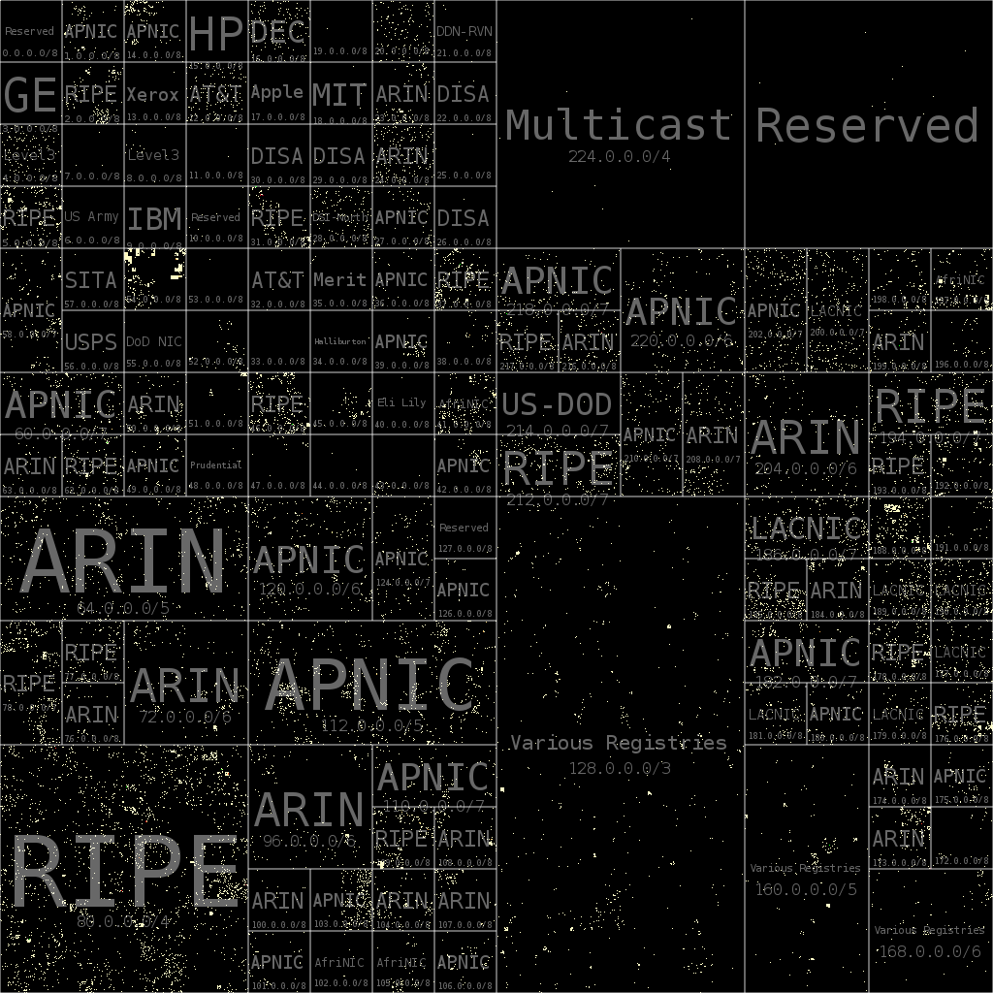
Network IoC and Attacker Costs
IoC | Buy | Rent
IPv4 | ~$ 14 | ~$2
IPv6 | ~$250 | ~$2
Domain | $1 | $1
Bitcoin count | $0 | N/A
SSL/TLS Certificates | $0-5 | N/A

Slide 5

Code and Binaries take time not money...
Marion to talk about measuring effort to alter binaries or source...

Slide 6
Logistical Burden
Measure what you can:
How many binaries in sofacy campaign over time?
Estimate what you can´t measure:
Software development cost, personnel
Stealth cost
Hiding is tedious
Operations < Infrastructure

Slide 7
Cost of Attack
Time
Skills
Tools
Hardware
Software
Personnel
Offices
Salaries
Insurance
Taxes?

Slide 8
Cost of Attack
Time
Skills
Tools
World class exploit developer $250k/year
Estimating cyber war costs: $45.9 Mio/year
Estimated costs for development of Stuxnet: $500k
APT1 group thoroughly exposed in Feb. 2013, back in business 160 days after exposure

Slide 9
AV-TI Paradox: Selling less for more
An observation of rigged business models
AV sells detection products, with a cumulative data feed; TI now sells singular standalone feeds
Cost of TI data limits coverage, limitations on TI heavier than ever seen in AV
No independent evaluation results of TI data available as of today
Notes:
Hilarious to watch, and a bit scary

Slide 10

Moarrrr IoC
We can‘t find the needle in the haystack, give us more hay!
Notes:
In malware classification I learned that every malware offers a great set of features, but sadly they don‘t usually perfectly overlap among different samples

Slide 11
Threat Detection: The hay that we got
File hashes
File fragments
File behavior
File properties
System behavior
Network patterns
Abnormal system behavior
Abnormal network patterns
Known-bad
Non known-good
Known-bad origin
Non known-good origin
Threat detection metrics heavily build on known fragments, while aiming to find the largely unknown.

Slide 12

The problem we got with the hay
The time blind spot
The geographical blind spot
The data quality blind spot
Historical data is gold
Sensors in China deliver TI for China
Can’t compare a file hash to a domain name, can you?

Slide 13
Sample geometry
File size
Section data, sizes, entropies
Imphash
Original file name
Compilation timestamp
Many many more
Most common approach, rather pointless

Slide 14
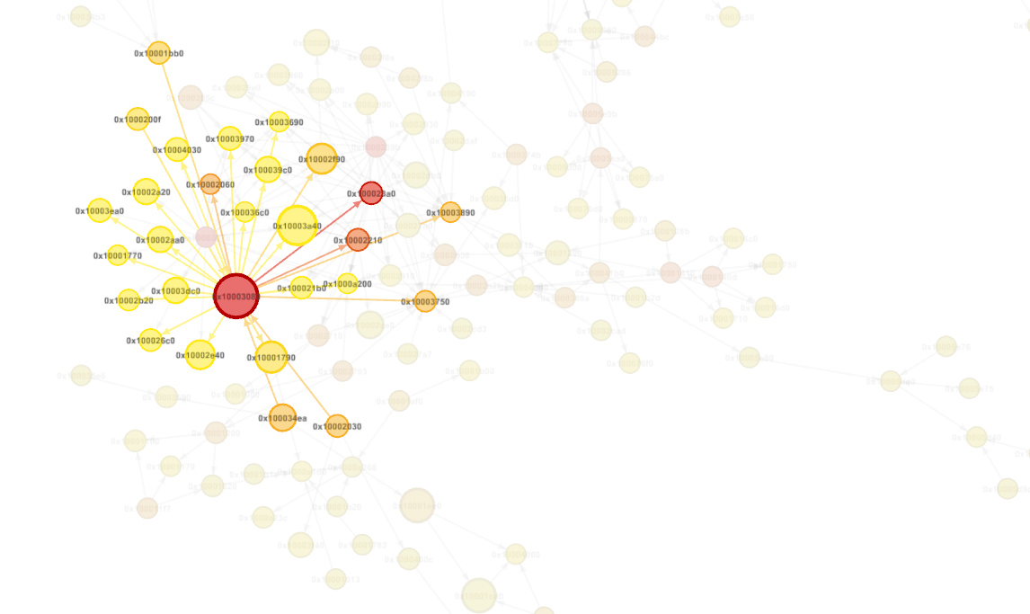
Call graph layout
Call graph reconstruction with radare2
Local functions, API calls, strings
Measuring the graph
functions edges calls ratios
sizes
paths

Slide 15
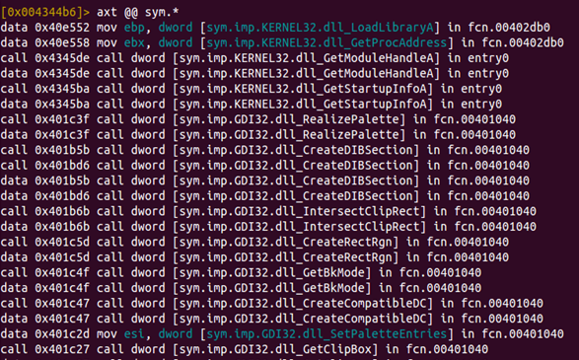
API calls
Interface between software and operating system
Windows executables w/o API calls highly unlikely
Documented - mostly..
Frequently „hidden“ within malware

Slide 16
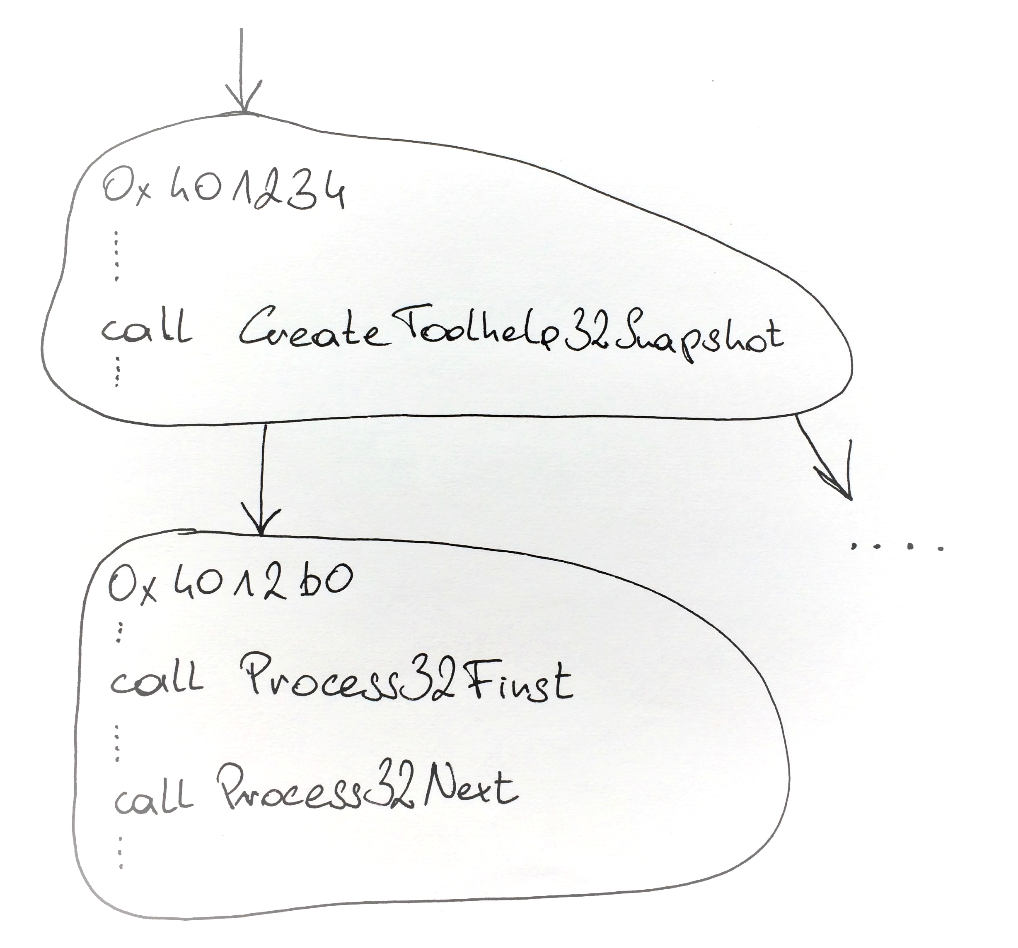
Scanning for Gadgets
Singular gadgets to count e.g. API resolution, memory allocations
Pre-defined API patterns
Searching the graph for anchor
Scanning nodes in close vicinity

Slide 17
Behaviorgadgets: An IRC-Bot
For SEND found {'send': '0x40128a'}
For SEND found {'send': '0x401ad5'}
For SEND found {'send': '0x402315'}
For SEND found {'send': '0x4016d2'}
For CREATEPROC found {'CreateProcess': '0x402aa1'}
For EXITSYSTEM found {'ExitWindows': '0x402aa1'}
For CREATETHREAD found {'CreateThread': '0x402aa1'}
For APILOADING found {'GetProcAddress': '0x407313'}
For RECV found {'recv': '0x402230'}
For RECV found {'recv': '0x40198f'}
For REGSETVAL found {'RegOpenKey': '0x402670', 'RegSetValue': '0x402670'}
Which gadgets, how often => matrix

Slide 18
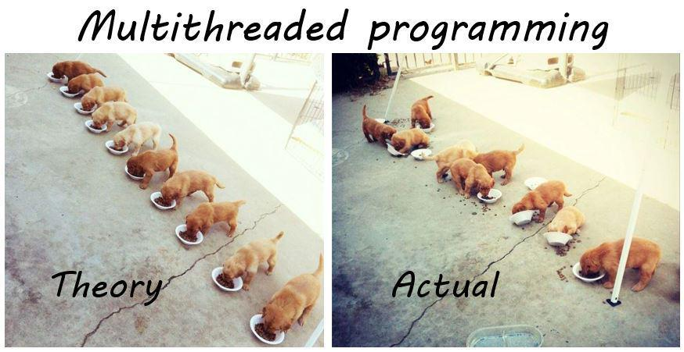

Slide 19
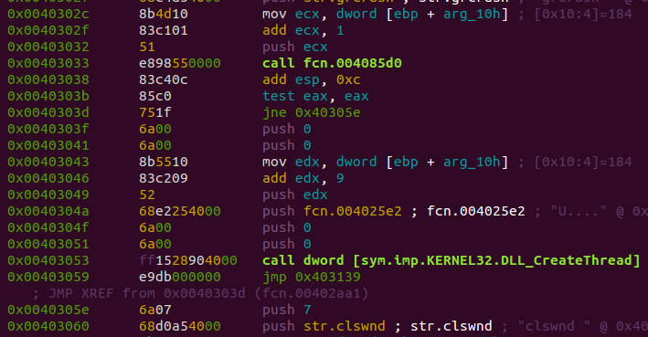
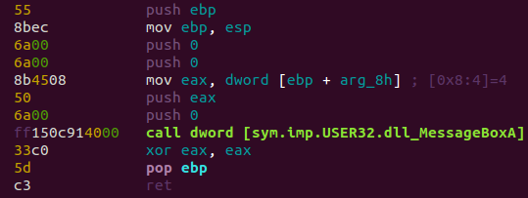

Slide 20
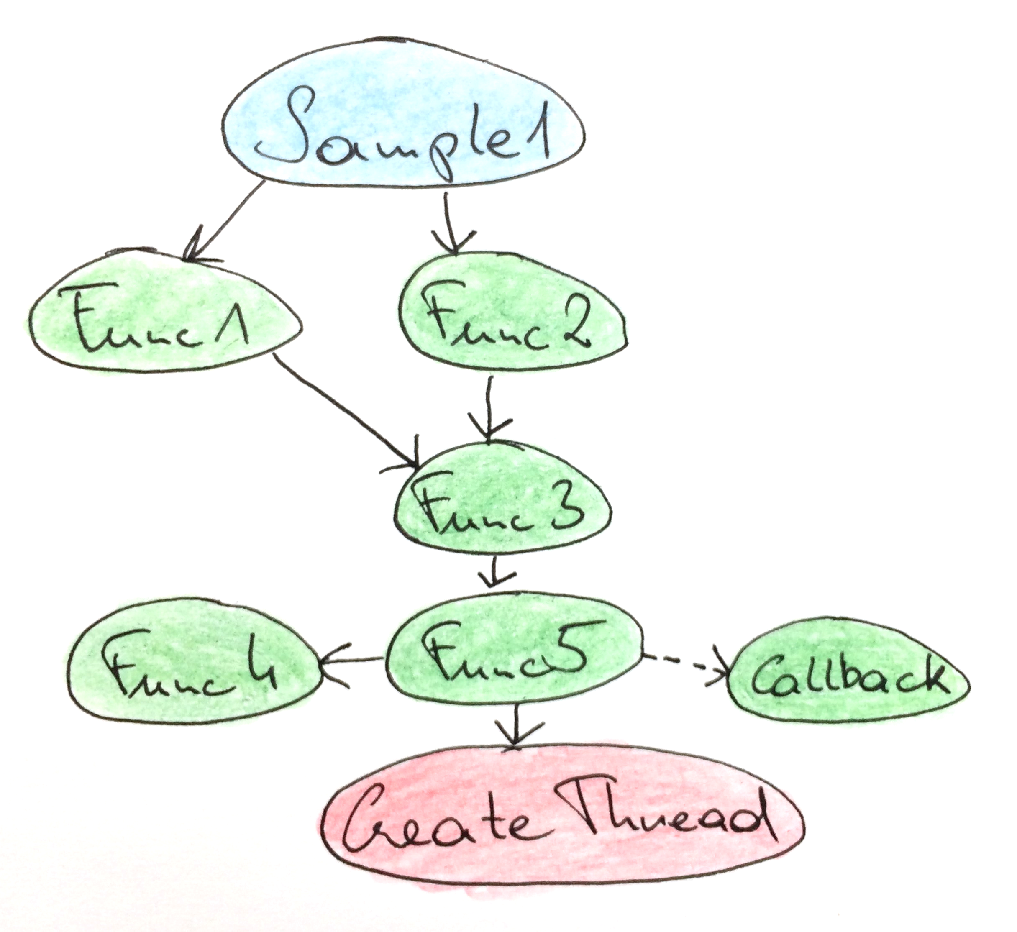
Thread Model Modelling
Number of calls to CreateThread
Shortest path to CreateThread
Number of handler functions
Average size of handler functions
Size of biggest handler function

Slide 21
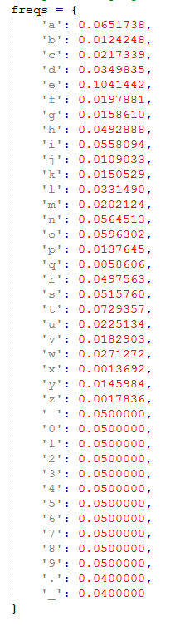
String Contstants
Human readable strings give information away
Presence or absence of readable strings is relevant information
Graph structure, character frequency and character repetition allow string constant evaluation

Slide 22
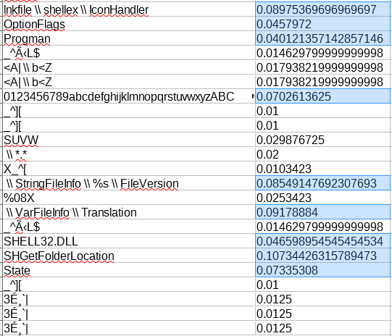
CheshireCat
Spot the cat..

Slide 23
String character frequency histogram per sample
2-0-7-9-31-0-0-3-30
2-2-7-12-37-1-0-4-38
2-8-8-11-39-1-0-4-38
2-4-7-13-37-5-0-3-34
3-5-7-16-40-6-0-4-38
2-5-7-14-36-5-0-3-38
3-6-7-12-35-4-0-3-30
2-4-7-13-29-5-0-3-29
2-4-7-7-27-0-0-3-29
3-4-7-10-27-0-0-3-29
3-4-7-12-27-4-0-3-29
13-233-274-464-276-1381-1895-265-190
13-233-274-464-276-1381-1895-265-190
2-2-5-11-25-1-0-4-46
2-2-5-11-25-1-0-4-46
2-2-5-11-25-1-0-4-46
2-2-5-11-25-1-0-4-46
2-2-5-11-25-1-0-4-46
3-0-3-8-13-0-1-3-2
3-1-3-8-13-0-1-3-2
3-1-3-8-13-0-1-3-2
12-195-121-175-177-769-1319-75-49
12-195-122-175-177-784-1324-76-50
12-194-123-163-184-786-1308-81-49
12-195-120-156-188-781-1308-76-47
12-195-121-158-163-785-1323-73-43
12-195-122-157-187-770-1255-76-48
12-195-123-156-183-769-1324-73-49
9-193-101-134-160-757-1277-76-48
12-195-121-160-189-786-1304-81-49
Subset of Sofacy
Stepping by 0.01
0.04 is a reasonable edge
Resilient to little changes
Short strings are an issue

Slide 24
Node‘s mnemonic distribution
Arithmetic instructions as indicator for cryptography, compression or codecs
Leveraging radare2‘s instruction type
shl
shr
mul
div
rol
ror
sar
load
store

Slide 25
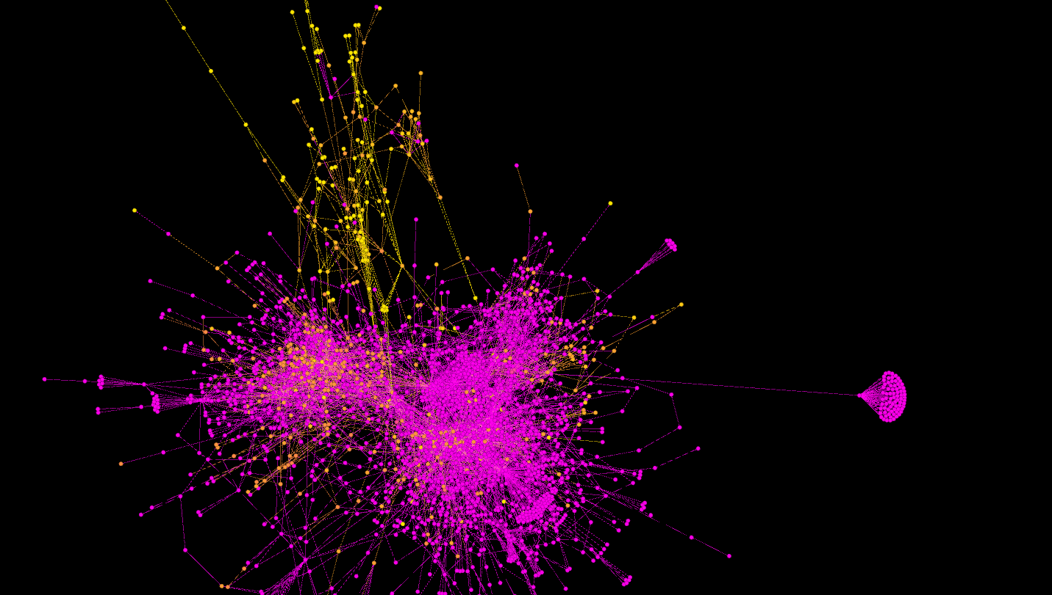
Babar

Slide 26
Feasibility
Files >2mb problematic
Radare out-of-the-box PE analysis needs overhaul
Parsing time <1s – ~1h
Still on POC stage
Parse once, derive features foreva
Fully open-source, scales well

Slide 27
And the packers?
Any protection stragety a malware author applies only serves a limited set of goals

Slide 28
The AV Factor
Packrat as "APT" using runtime packers, repetitive use of packers, infrastructure connects different attacks
targeted attacks are becoming cheaper as techniques are being reused, APT as a service maybe
Research on commodity RATs from I4CS Vienna
Enterprise networks vs. private computers and the runtime packers

Slide 29
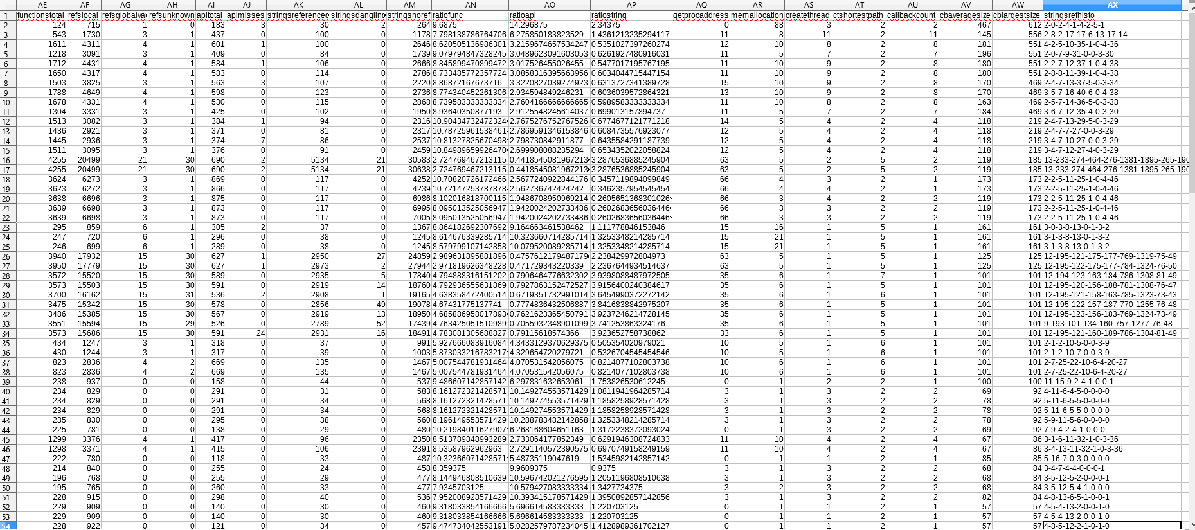
DATA
Testdata for APT28, Packrat, Animalfarm and others soon to be released on github

Slide 30
Discussion: Cost, Scalability, Resilience, Reliability
Cost: parsing time and setup, cost to deploy, cost to maintain
Scalability as in flexibility
Resilience: compiling robustness, packers
Reliability: the radare issue
extraction
change
application/deployment
resilience and expiry time

Slide 31
Indicator cost types
extraction
application/deployment
resilience and expiry time

Slide 32
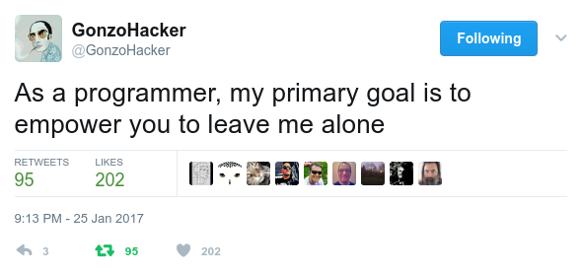
Feature integration with MISP

Slide 33

Feature integration with MISP
Objects to group indicators as one entity
Feasible way to extract the indicators from binaries & graphs
Organise, store & display everything
Means for object interconnection & correlation
Flexibility & scalability
Notes:
Not sure how often you used the DOS headers in an investigation, but MAEC allows you to share that.
Protip: don’t base your backend on a standard described solely in an office document… or the new version is totally incompatible with the old one.

Slide 34

MASTERPLAN
Object definition which can be plugged into MISP
PE & graph feature extraction
Mapping of features to object definition
Generate a JSON file in MISP Object format
Implementation of objects in MISP core
Objects for other file formats
Integration of the feature generator in the STL
Soon-ish: string search, automatic correlation on per-instance basis
Later-ish: behaviour gadget search, straight from the graphs

Slide 35
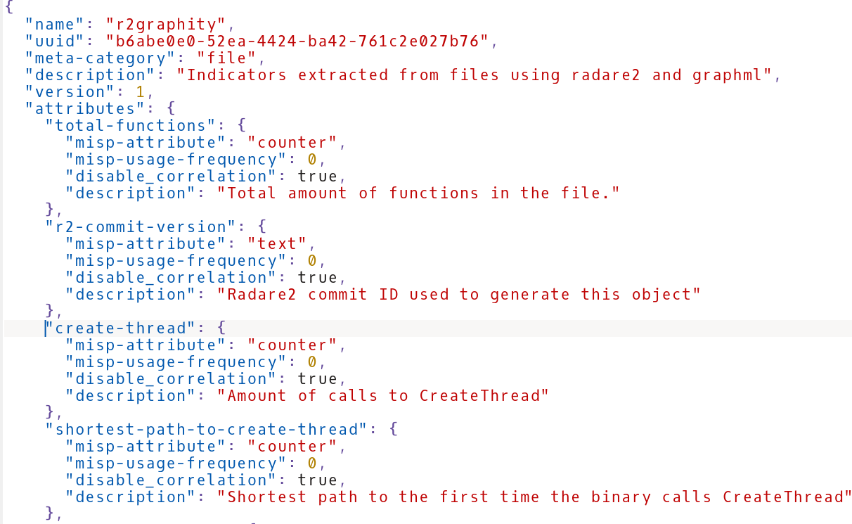

Slide 36
Conclusions etc.
The IoC ecosystem – sharing and caring for driving up attack costs
How possible is it to drive attackers out of business?
Sharing indicators done right will not disclose who you are or that you were breached
Driving down cost of defense will sooner or later drive up cost of attack
The average attacker doesn‘t write exploits or design intrusions or even write malware, but does copy paste and send e-mails all day

Slide 37
Ctd.
Money is a factor always, cause even in state sponsored hacking we can say that Somalia definitely doesn't have the same resources to spend as the US
State hacking tools sold today for compromise of "terrorists" could in the future very well be reused for economical targets or other nation state targets
reuse is a weak spot, common TI just like AV relies on reuse of code and infrastructure

Slide 38
Ctd.
Currently no established method to evaluate the sophistication of a threat or threat actor.
Success of an attack does not correlate with sophistication of an attacker.
Resilience of the target network, does.
Attacker sophistication is somewhat closely related to attacker budget.
Again, no attacker has infinit budget.
By driving up attack costs infosec can improve security for all.
Taking out attacker tools does not necessarily do the job.

Slide 39

thank you

